Slide 1





K-12 Grant
Year End Report
Ben Franklin Academy
2022 - 2024

Slide 2

What’s the Collaborative SCFD K-12 Grant?
The SCFD is a voter supported sales and use tax in Adams, Arapahoe, Broomfield, Boulder, Denver, Douglas and Jefferson counties. Just one penny on every $10 in sales and use tax collected goes to SCFD who fund over 300 nonprofit organizations.
The Collaborative of the SCFD is a membership organization of SCFD-Funded organizations who invest a portion of their yearly SCFD Award to support our
K-12 School Grant. Selected school applicants receive a variety of in-school workshops, assemblies, field trips, in-school exhibits, bus support and more.

Slide 3

Through the Collaborative SCFD K-12 Grant, your students have experienced
51 different programs and 81 total program sessions!
Arvada Center for Arts and Humanities
Butterfly Pavilion
City of Aurora Cultural Services
Central City Opera
Cherry Arts
Children's Museum Denver Marsico Campus
Colorado Children’s Chorale
Colorado Ballet
Colorado Symphony
Denver Center for the Performing Arts
Lakewood Heritage Culture & the Arts
Lone Tree Arts Center
Pop Culture Classroom
Swallow Hill Music
Town of Parker, Parker arts
Wings Over the Rockies Air & Space Museum
The students and teachers at Ben Franklin Academy worked with 16 different cultural organizations all throughout Colorado!

Slide 4


$19,264.98 worth of cultural programming was awarded to and utilized by your school!
$2,675 was awarded for bus funding, $960 was awarded for substitute teacher funding, and $200 was awarded for library resources!
This funding is provided by the SCFD: a seven-county tax district created within Colorado law, approved by Colorado’s General Assembly, and renewed by voters multiple times over more than 30 years.

Slide 5
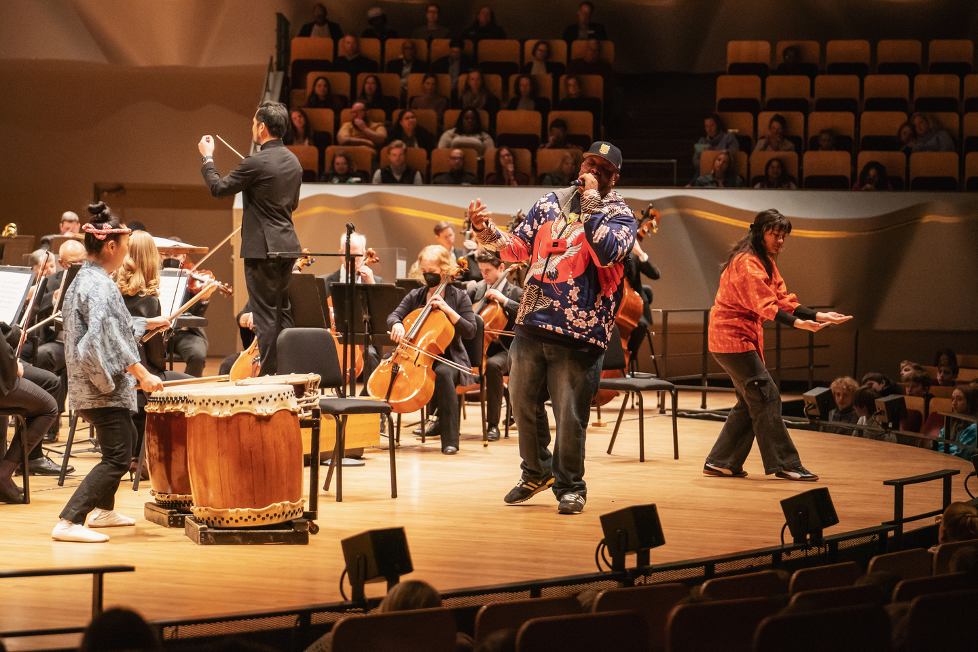

The Collaborative SCFD K-12 Grant was able to provide programming from Pre-K through 8th Grade!
The diverse programming offered by the Collaborative SCFD grant was able to serve students of every grade level at Ben Franklin Academy.

Slide 6

Unique programs delivered to your student body served a total of 8,662* students over the past two years*
These programs also served 1,974* adults in the Ben Franklin Academy network (parents, teachers, and staff)
*This number indicates the total numbers served and may include repeat patrons

Slide 7

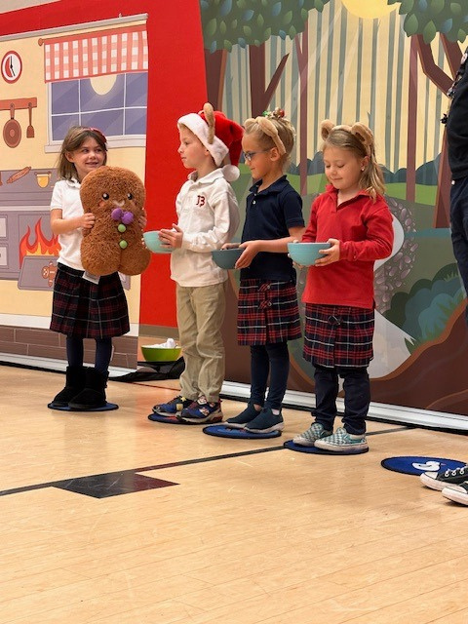

Of the 51 programs...
5 were Field Trips
18 were Assemblies/Large Format Programs
28 were Workshops

Slide 8
Summary:
Your students have experienced 81 different programs!
$19,264.98 worth of cultural programming was awarded to and utilized by your school!
$2,675 was awarded for bus funding, $960 was awarded for substitute teacher funding, and $200 was awarded for library resources!
The students and teachers worked with 16 different SCFD* Funded cultural organizations all throughout Colorado!
The programming served a grand total of 8,662* students from Pre-K to 8th Grade and 1,974* adults over the past two years
*This number indicates the total numbers served and may include repeat patrons
Of the 51 programs...
5 were Field Trips
18 were Assemblies/Large Format Programs
28 were Workshops

Slide 9

Powered by 4 dedicated teachers:
Laura Tickle
Jaime Johnson
Ali Hinkle
Brenda Bauer

